Slide 1
Django
Notes : Django is python frameworks using library .
This notes helps us that improve urknow

Slide 2
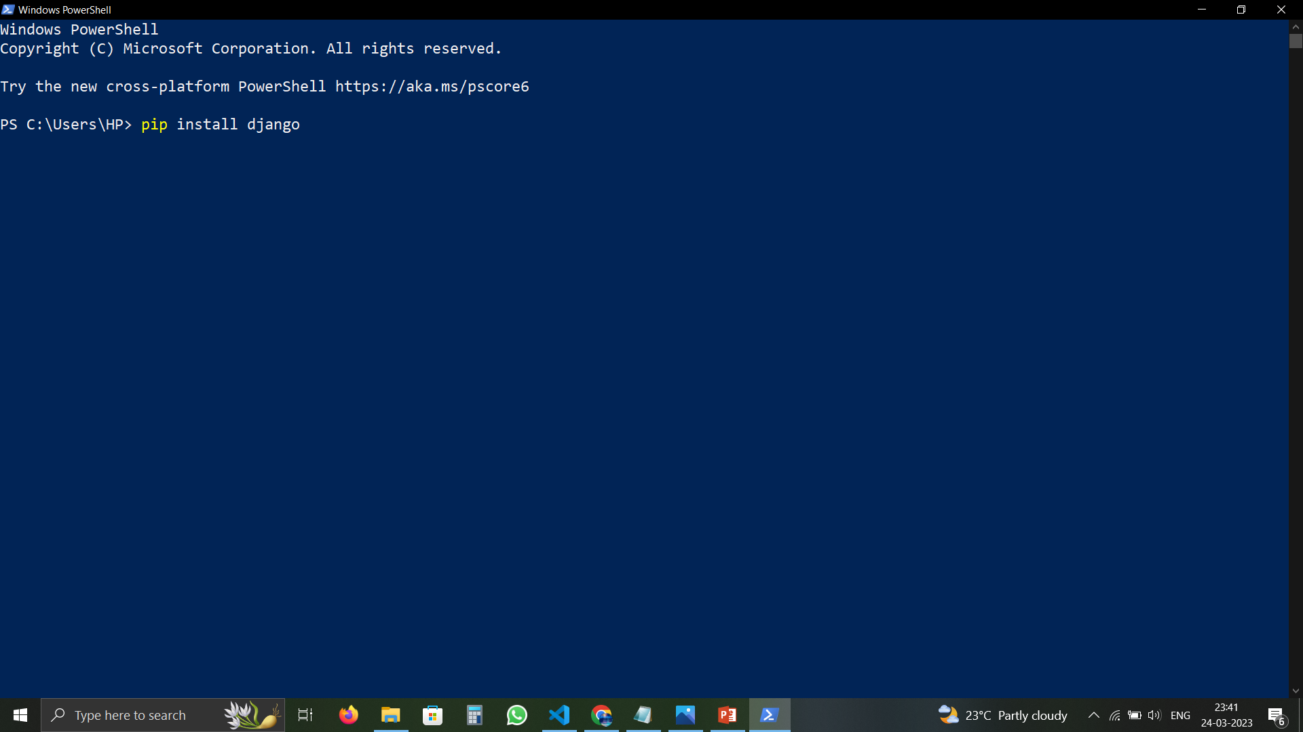
Django installation
Open in window powershell -→>>>>> pip install django

Slide 3
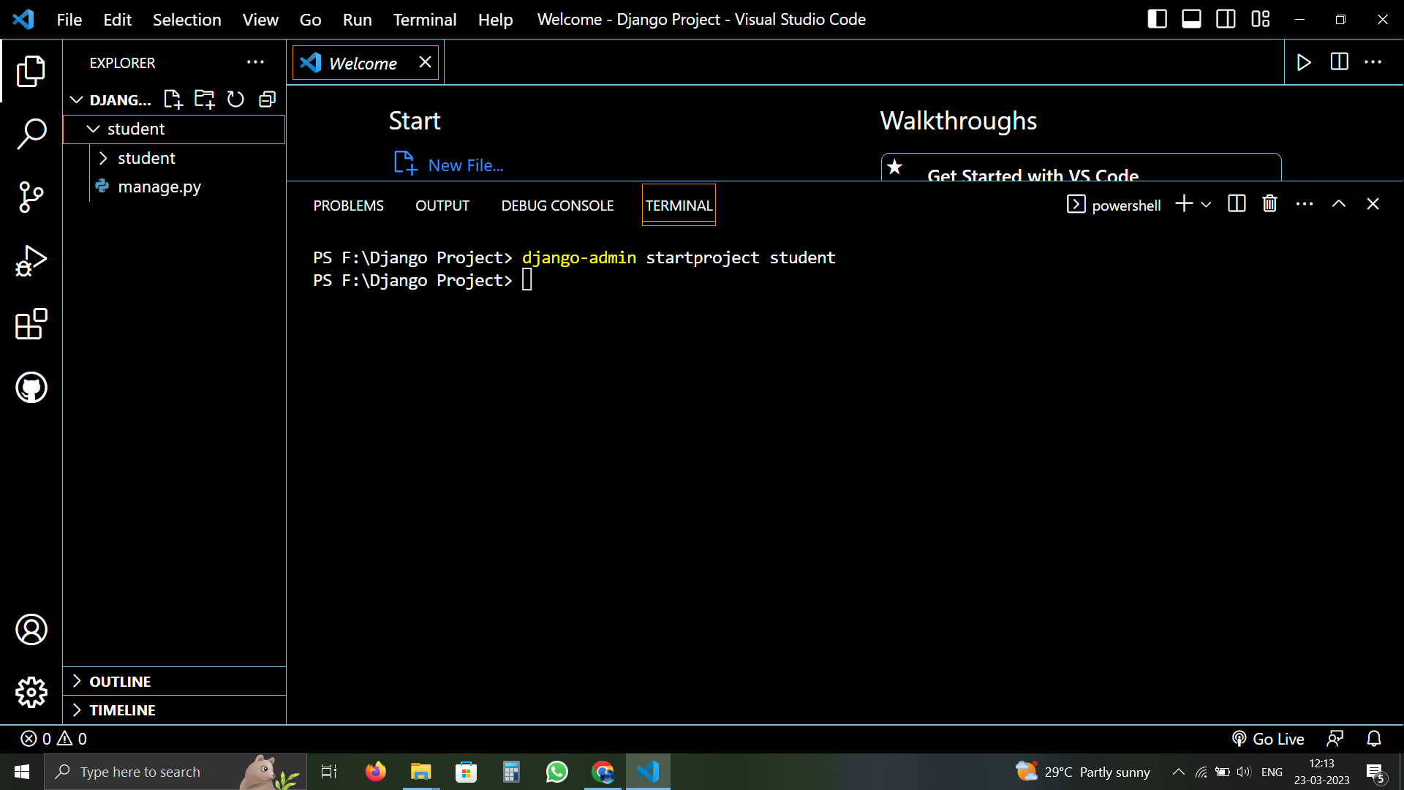
Create project by Editor terminal :- django-admin startproject Project name :

Slide 4
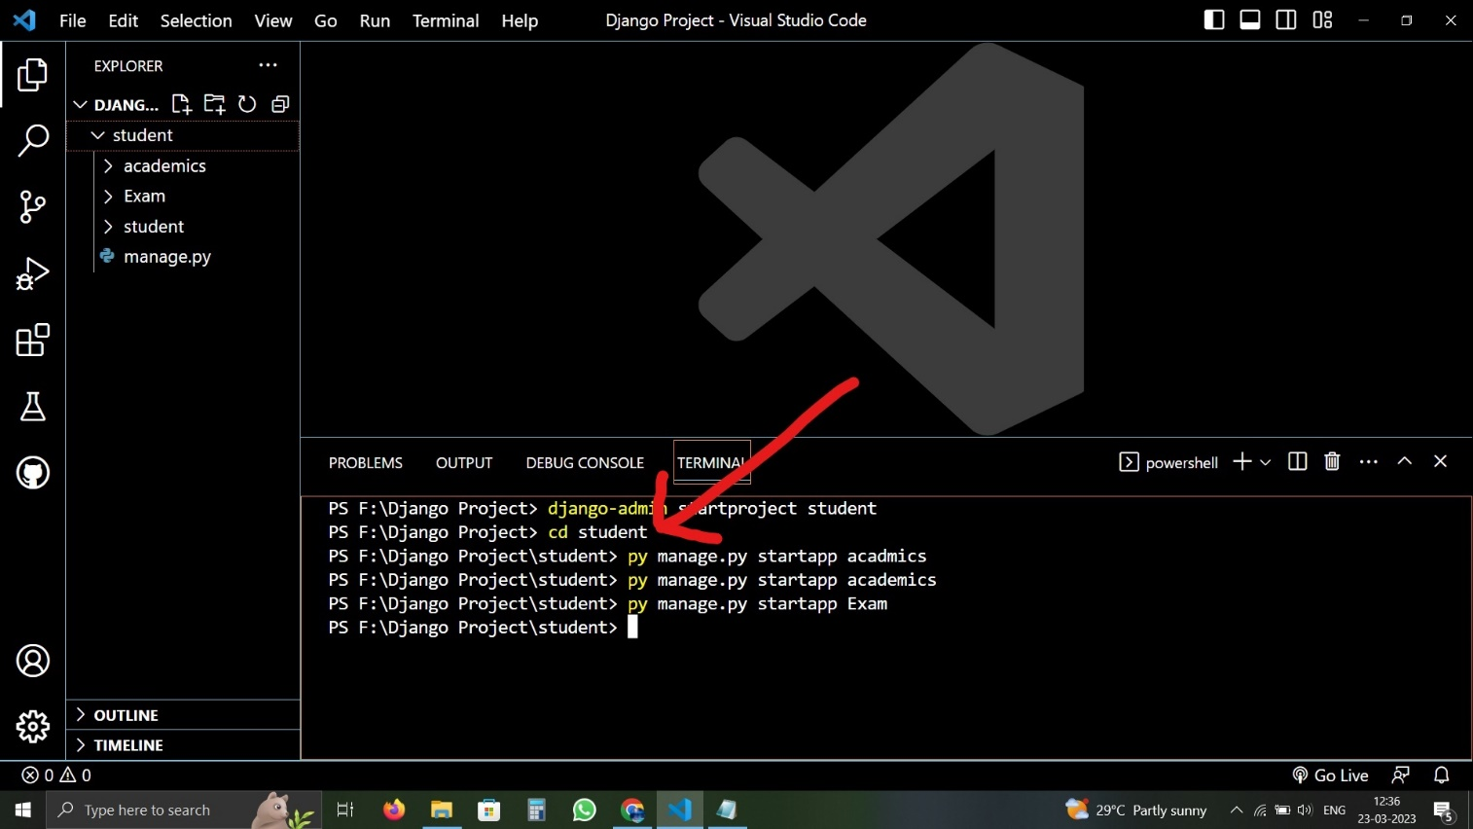
And go to project folder :-cd project name

Slide 5
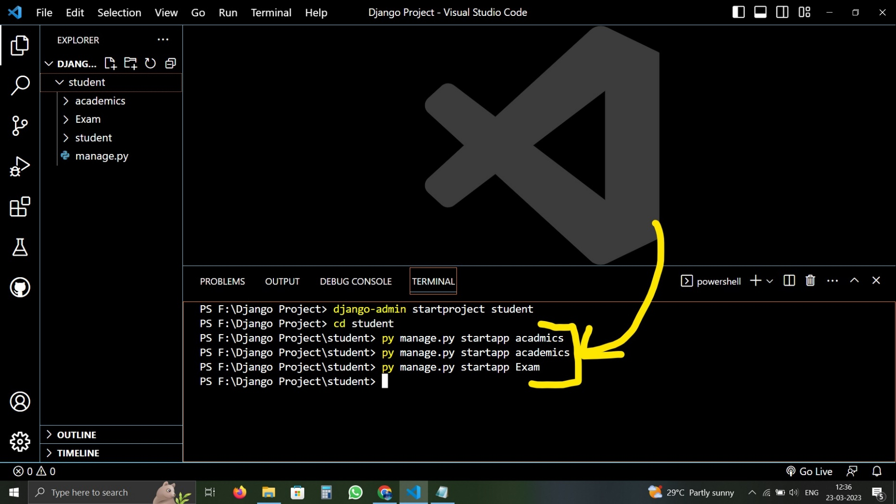
Create Application using Django Editor
create applaction by Editor terminal:-py manage.py startapp Applaction name

Slide 6
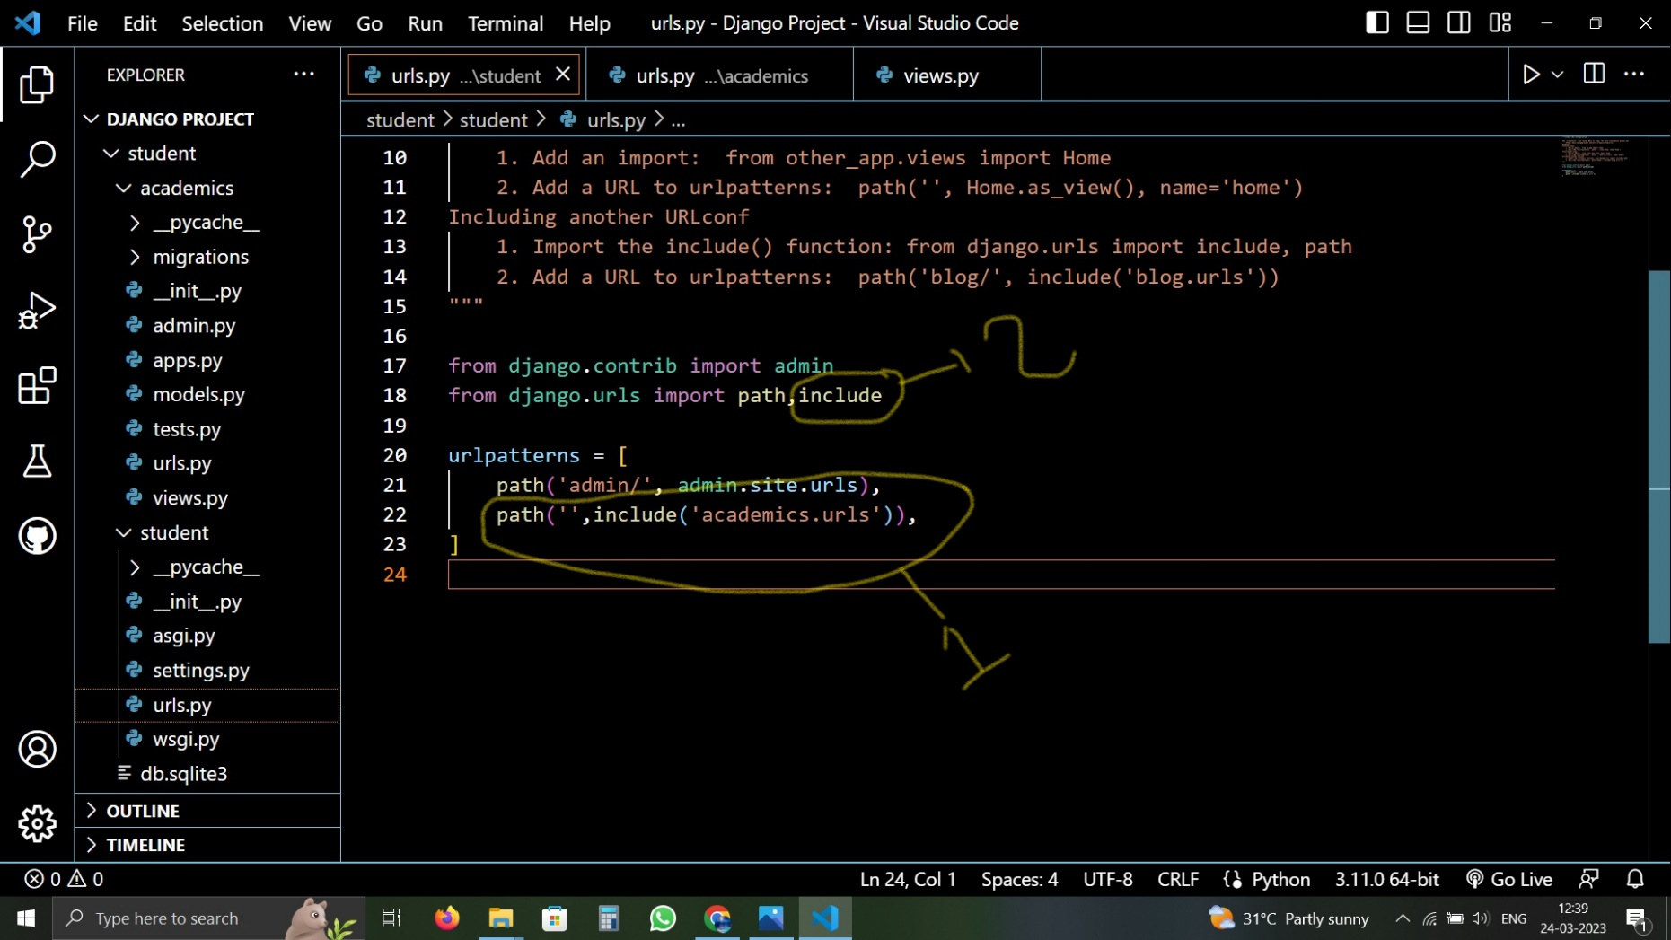

Slide 7
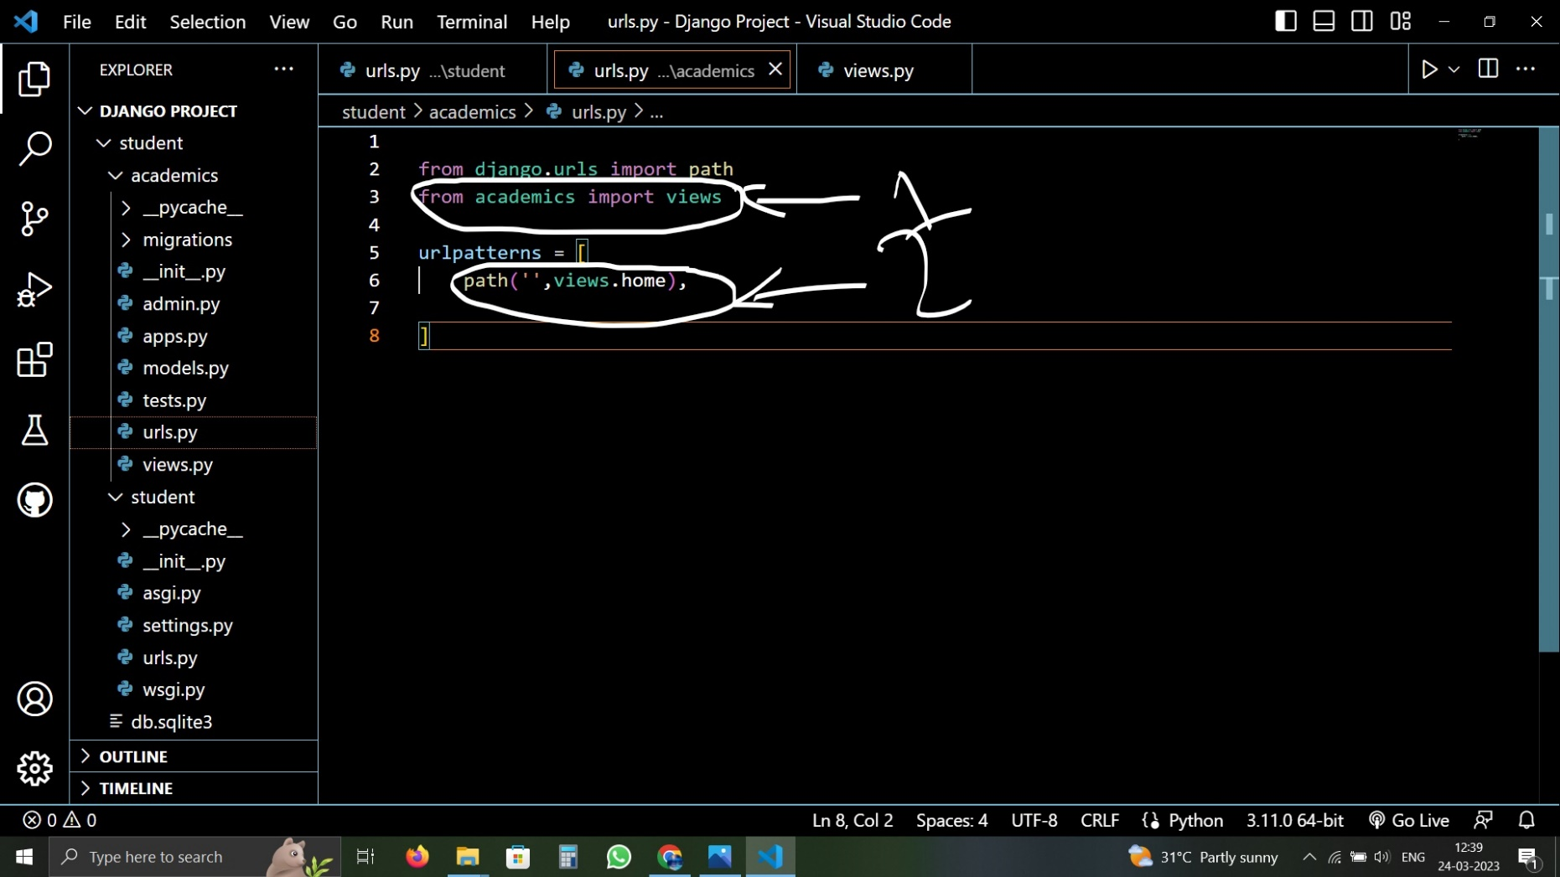

Slide 8
